Slide 1
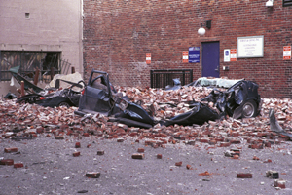
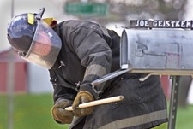
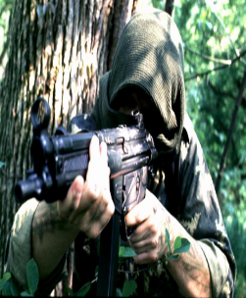
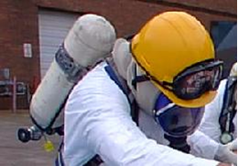
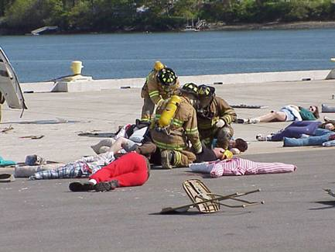
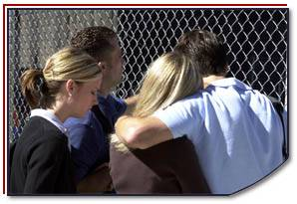
Disaster Site Worker Safety
Personal Protective Equipment (PPE)

Slide 2
Objectives
Describe specific conditions that determine PPE level selections.
Describe the Levels of PPE for Disaster Site Workers.
Identify the physiological and psychological stressors that can affect users of all Levels of PPE.
Discuss challenges and techniques for communication while working in Level C PPE.
Properly don and doff the Level C protective clothing and respiratory protection.
Discuss the limitations while wearing PPE.

Slide 3
Worker Protection Against CBRNE Agents
PPE for use against CBRNE agents consists of respiratory and dermal protection.
The level of protection that is required will depend upon:
The specific agent.
The conditions under which the equipment is worn.
The activities and exposure level of the personnel.

Slide 4
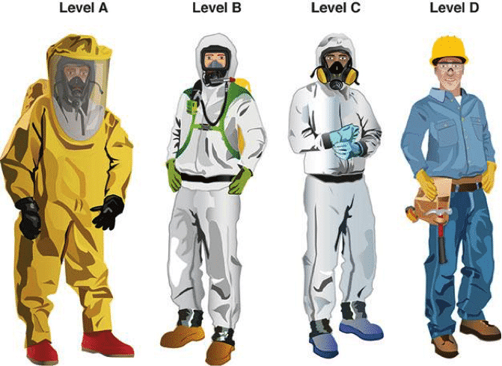
Levels of Personal Protective Equipment
Personal protective equipment is divided into four (4) based on the degree of protection afforded.
Disaster Site Workers will be working in:
LEVEL C
LEVEL D

Slide 5
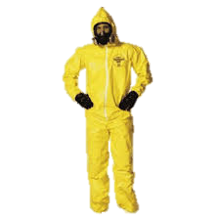
Level C
Level C – CRITERIA
The concentration(s) and type(s)of airborne substance(s) is known and the criteria for using air purifying respirators are met.

Slide 6
Level c
RESPIRATORY
Full face with cartridges approved for the type of exposures
Half Mask Air Purifying Respirator (APR)
SUIT
Chemical-resistant clothing
One-piece coverall
Hooded two-piece chemical splash suit, chemical-resistant hood and apron, or disposal chemical-resistant coveralls
Gloves – Inner & Outer
FOOT
Chemical resistant
Steel toe & shank

Slide 7
Level C
Optional items:
Protective inserts (as needed)
Cloth coveralls
Radio
Hard hat
Escape mask

Slide 8
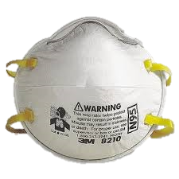
Respiratory Protection
Air-Purifying Respirator (N95)
Full & Half Mask with cartridges
Powered Air-Purifying Respirators (PAPRs)

Slide 9
Air-Purifying Respirators
Air-purifying respirator (APR)
Filter(s)
Powered air-purifying respirator
Qualitative and quantitative fit testing

Slide 10
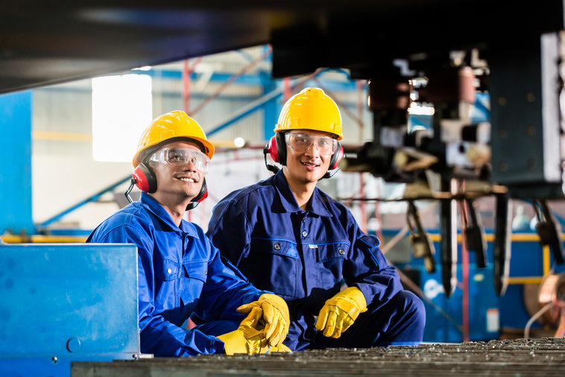
Level D
Level D – CRITERIA
Protection is primarily a work uniform and is used for nuisance contamination only. It requires only coveralls and safety shoes/boots.
Other PPE is based upon the situation (types of gloves, etc.). It should not be worn on any site where respiratory or skin hazards exist.

Slide 11
Safety and Mission Duration
Physiological stressors
Heat stress
Work rate
Ambient temperature
Physical condition of the worker
Psychological stressors
Working in an unknown environment
Working in PPE
Acute traumatic stress
Casualties and fatalities
Terrorist act itself
Behavioral
Emotional
Notes:
Acute Traumatic Stress –
Consisting of Casualties, fatalities and acts of terrorism will play an emotional role on the DSW. This is an “ACUTE” onset and different from “Emotional Stressors”.

Slide 12
PPE review
Must have completed training for the PPE that will be used.
Always use PPE within its standard protection limits.
Take steps to reduce PPE heat stress.
ACTIVITY

Slide 13
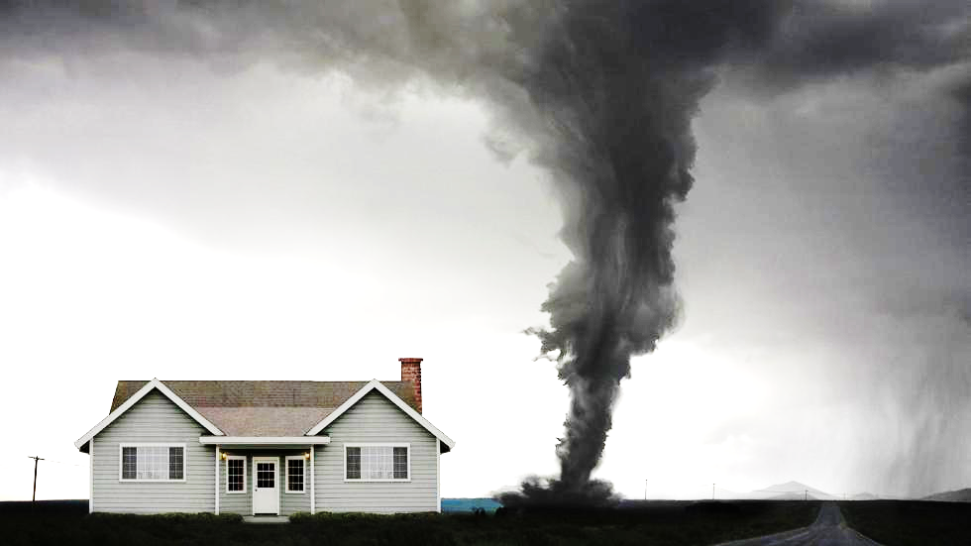
Dashboard
DECON

